Slide 1
Data Science Capstone Project – My Pipe Dream: Opening a NY Style Deli in North Carolina
Lauren Crowe

Slide 2
Problem Statement:
I have always desired to open a NY Deli and Sandwich shop, as I grew up waitressing in one. I loved the people and the atmosphere. North Carolina is overrun with chain deli shops like Jimmy Johns, Jersey Mike’s, etc. so I would like to find a location close to family where a small business would thrive without excess competition.
I am from Greensboro, NC and have the option of opening this shop in Charlotte (where I currently live) or Greensboro NC.
Since this decision would require a substantial financial input on my part I need to determine which city and neighborhood within the city selected has reasonable rent costs. Once I select a city, I want to understand which areas of the city have the most Deli/Sandwich shops so that I can select an area that doesn't have an oversaturated market.
Even though this is a pipe dream of mine, anyone who is interested in opening a restaurant would benefit in leveraging Data Science to make an educated decision before selecting a location to open any restaurant or venue.

Slide 3
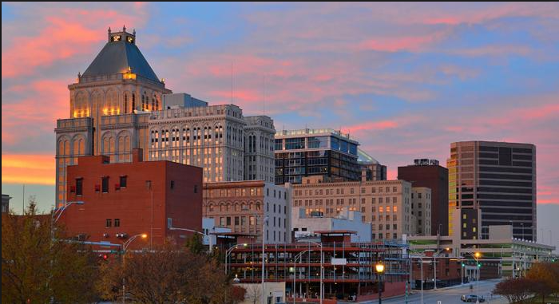

Data Acquisition and Cleaning:
Web based search on Top 50 - Highest Zip Codes in NC for Rent (downloaded as csv) and imported from this site.
Geospatial Data for all US Zip Codes from this site (downloaded as csv) to determine all zip codes lat/longs to be leveraged for FourSquare Venue search, and Clustering Analysis.
FourSquare Venue search based on Greensboro Zip Code as input for Clustering Analysis. Narrowed foursquare search to eliminate irrelevant venue types for cluster analysis.
Paired cluster analysis data output with research on most popular neighborhoods to live to select a restaurant location and living location with little travel.
Or?

Slide 4
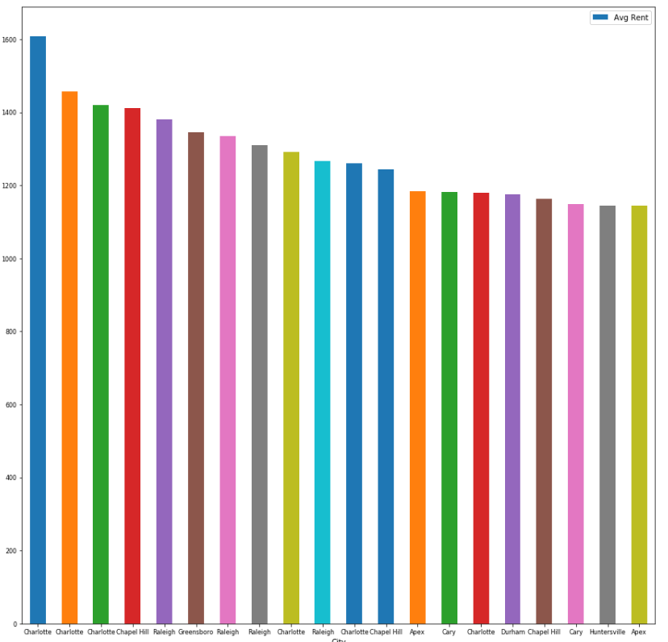
Methodology- Exploratory Data Analysis:
Visualizing the top 20 Zip Codes in NC proved a good exercise where it was found that 7 of the top 20 Zip Codes for Rent Cost are in Charlotte, and 1 is in Greensboro. Considering this data, it was easy to make the determination to focus my analysis on a location for my Deli/Sandwich shop in Greensboro, NC and chose to avoid zip code 27403 in Greensboro.

Slide 5
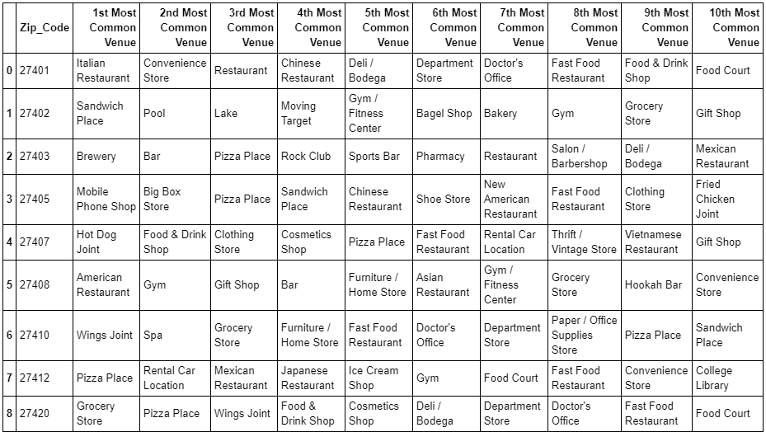
Methodology- Exploratory Data Analysis:
Tying the Greensboro zip code geospatial data to the Foursquare venue data in a dataframe was critical to allow for levering K-means clustering unsupervised learning techniques and visualizing most common venues by zip code to narrow my search to an area not over populated by other Deli/Sandwich shops.

Slide 6
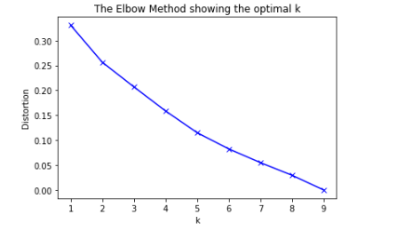
Methodology- Exploratory Data Analysis:
Elbow Method revealed that 2-3 clusters were optimal for the K-means fit algorithm using the Zip Code Top 10 Venues Dataframe as an input. Note that there is no sharp elbow in this case so K-means was run under both 2 & 3 clusters and the cluster outputs were analyzed. Based on practicality and # of zip codes I was analyzing I chose 3 clusters.

Slide 7
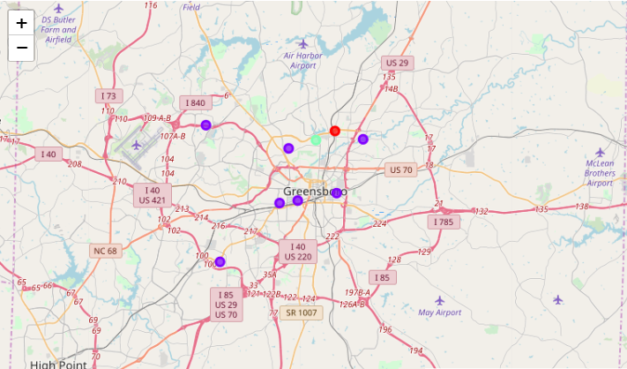
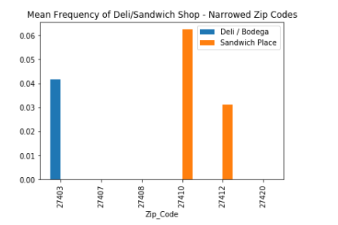
Methodology- Exploratory Data Analysis:
Combination of K-means cluster to narrow search to select 5 zip codes, along with analyzing mean frequency occurrence of Deli/Bodega and Sandwich Shops allowed for selection of a zip code to target for my restaurant location (27408).

Slide 8
Conclusions and Future Opportunities:
Geospatial data combined with web research and k-means clustering proved a successful method to narrow search for a restaurant venue location down to a specific zip code.
Foursquare data results were limited on number of venues returned even when opening the foursquare API call search limits and radius. In addition, Foursquare venue categories are inconsistent so it is hard to filter out all categories which are irrelevant to the analysis. For example, there is venue category of “Restaurant”, “American Restaurant”, “Pizza Restaurant”, etc. If you do not look at each venue title, clustering by venue category may prove to cluster restaurants incorrectly or in the case of this analysis create few clusters to differentiate venues because the categories are so broad. Therefore, other methods of analysis are necessary to combine with K-means to make an educated decision on a venue location.
Future use cases for selling this type of analysis as a service are evident, especially considering how much time I spent on this behind a computer versus the guess work and
K-means clustering algorithms could not be leveraged as a service to new small business owners seeking guidance on prime locations to open a new restaurant or any other kind of business.

